Slide 1
Time Card - Democratize Time Appliances
Ahmad Byagowi (OCP-TAP)

Slide 2
Open Compute Project Time Appliance Project (TAP)
https://www.opencompute.org/wiki/Time_Appliances_Project (www.ocptap.com)
Mission:
Work Streams:

Slide 3
Accuracy vs Precision in Sync
UTC
UTC
UTC
UTC
T1
T1
T1
T1
T2
T2
T2
T2
T3
T3
T3
T3
T4
T4
T4
T4
Not Accurate
Not Precise
Accurate
Not Precise
Not Accurate
Precise
Accurate
Precise
No Sync
Like NTP
Like PTP
Like PTP + Time Card

Slide 4
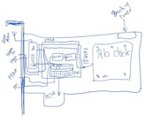
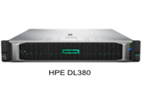
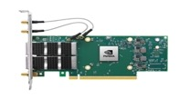
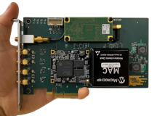
Open Time Server
Antenna
Time Card
GNSS Receiver
ToD
Clock Processing FPGA
PPS
Host CPU
NIC with PPS out (and/or) in
PCIe
PCIe
High Stability Oscillator
Discipline
PPS
Time Card
https://engineering.fb.com/2016/02/18/core-data/netnorad-troubleshooting-networks-via-end-to-end-probing/

Slide 5
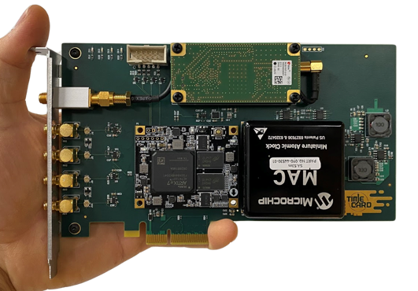
Time Card
Antenna
Time Card
GNSS Receiver
ToD
Clock Processing FPGA
PPS
PCIe
High Stability Oscillator
Discipline
PPS
https://engineering.fb.com/2016/02/18/core-data/netnorad-troubleshooting-networks-via-end-to-end-probing/

Slide 6
Time Card
Antenna
Time Card
GNSS Receiver
ToD
Clock Processing FPGA
PPS
PCIe
High Stability Oscillator
Discipline
PPS
Advanced “GPSDO”
Interface
https://engineering.fb.com/2016/02/18/core-data/netnorad-troubleshooting-networks-via-end-to-end-probing/

Slide 7
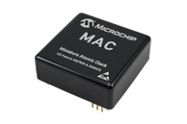
Advanced “GPSDO”
L1/L2
GNSS Receiver1
ToD1
Clock Processing FPGA
PPS1
PPS MAC
Optional
L1/L5
Discipline
High Stability Oscillator
PPS1
GNSS Receiver2
ToD2
PPS2
PPS2
https://engineering.fb.com/2016/02/18/core-data/netnorad-troubleshooting-networks-via-end-to-end-probing/

Slide 8
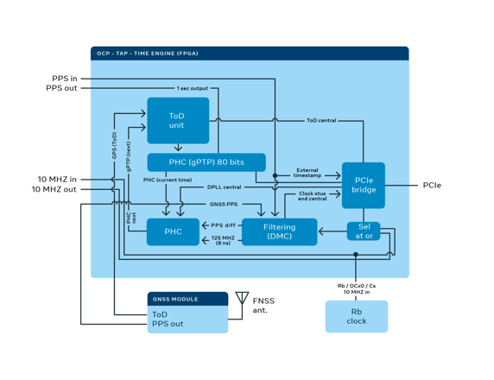
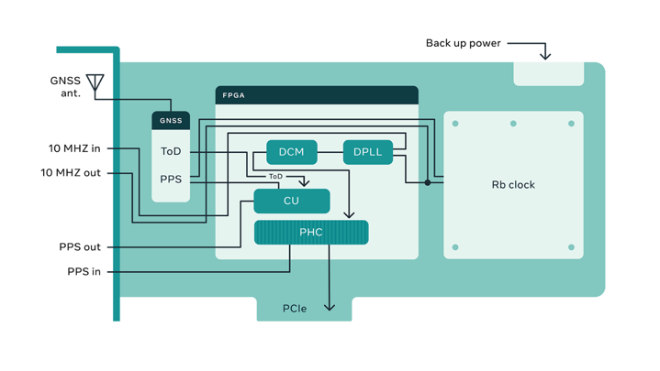
FPGA
https://engineering.fb.com/2016/02/18/core-data/netnorad-troubleshooting-networks-via-end-to-end-probing/

Slide 9
Interface
# ls -l /sys/class/timecard/ocp0/
total 0
-r--r--r--. 1 root root 4096 Oct 21 05:24 available_clock_sources
-r--r--r--. 1 root root 4096 Oct 21 05:24 available_sma_inputs
-r--r--r--. 1 root root 4096 Oct 21 05:24 available_sma_outputs
-rw-r--r--. 1 root root 4096 Oct 21 05:24 clock_source
lrwxrwxrwx. 1 root root 0 Oct 21 05:24 device -> ../../../0000:15:00.0
-rw-r--r--. 1 root root 4096 Oct 21 05:24 external_pps_cable_delay
-r--r--r--. 1 root root 4096 Oct 21 05:24 gnss_sync
lrwxrwxrwx. 1 root root 0 Oct 21 05:24 i2c -> ../../xiic-i2c.5376/i2c-0
-rw-r--r--. 1 root root 4096 Oct 21 05:24 internal_pps_cable_delay
-rw-r--r--. 1 root root 4096 Oct 21 05:24 irig_b_mode
drwxr-xr-x. 2 root root 0 Oct 21 05:24 power
lrwxrwxrwx. 1 root root 0 Oct 21 05:24 pps -> ../../../../../virtual/pps/pps6
lrwxrwxrwx. 1 root root 0 Oct 21 05:24 ptp -> ../../ptp/ptp12
-r--r--r--. 1 root root 4096 Oct 21 05:24 serialnum
-rw-r--r--. 1 root root 4096 Oct 21 05:24 sma1
-rw-r--r--. 1 root root 4096 Oct 21 05:24 sma2
-rw-r--r--. 1 root root 4096 Oct 21 05:24 sma3
-rw-r--r--. 1 root root 4096 Oct 21 05:24 sma4
lrwxrwxrwx. 1 root root 0 Oct 21 05:24 subsystem -> ../../../../../../class/timecard
-rw-r--r--. 1 root root 4096 Oct 21 05:24 ts_window_adjust
lrwxrwxrwx. 1 root root 0 Oct 21 05:24 ttyGNSS -> ../../tty/ttyS4
lrwxrwxrwx. 1 root root 0 Oct 21 05:24 ttyGNSS2 -> ../../tty/ttyS5
lrwxrwxrwx. 1 root root 0 Oct 21 05:24 ttyMAC -> ../../tty/ttyS6
lrwxrwxrwx. 1 root root 0 Oct 21 05:24 ttyNMEA -> ../../tty/ttyS7
-rw-r--r--. 1 root root 4096 Oct 21 05:23 uevent
-rw-r--r--. 1 root root 4096 Oct 21 05:24 utc_tai_offset
PCIe
PCIe x1 (18 pins) generation 1.0 or above on a x4 form-factor
Generic, supporting multiple OS versions
Exposes PHC device in Linux (/dev/ptpX) as well as PPS (/dev/ppsY)
Exposes leap second indicator to a shared memory segment read by chrony/ptp4l
1PPS / 10MHz SMA output
1PPS / 10MHz SMA input
IRIG-B input output
DCF77 input output
Driver is included in the mainstream Linux Kernel
Initial primitive version (5.2)
Exposing all devices version (5.15)
https://engineering.fb.com/2016/02/18/core-data/netnorad-troubleshooting-networks-via-end-to-end-probing/

Slide 10
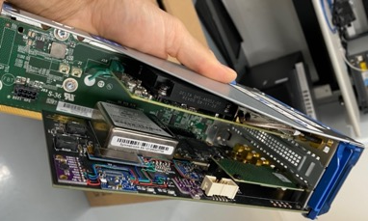
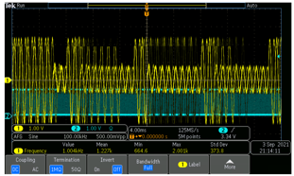
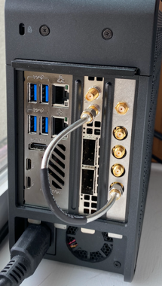
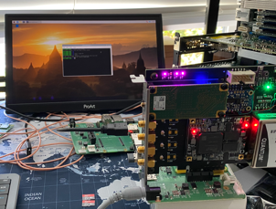
How to use it
For PTP Time Server (Grandmaster)
Via PCIe (PHC2SYS)
Via PPS (TS2PHC)
Via Reverse PPS (in progress)
For NTP Time Server
Via PCIe (Chrony)
For Camera and Audio Systems
IRIG-B
PPS
Other Applications
Bipolar and Multi Channel TDC (Multiple PPS in)
Over PCIe Event Time Stamping
https://engineering.fb.com/2016/02/18/core-data/netnorad-troubleshooting-networks-via-end-to-end-probing/

Slide 11
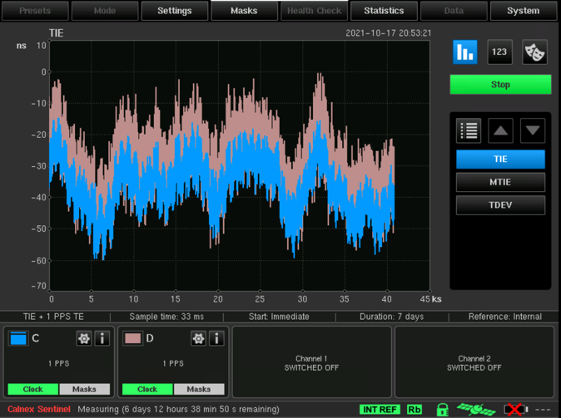
Performance
Time Card
PPS out
NIC
NIC
PPS in
PPS out
PTP over ethernet
PPS out
C
D
https://engineering.fb.com/2016/02/18/core-data/netnorad-troubleshooting-networks-via-end-to-end-probing/

Slide 12
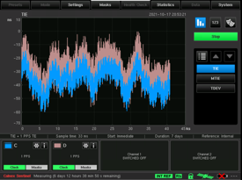
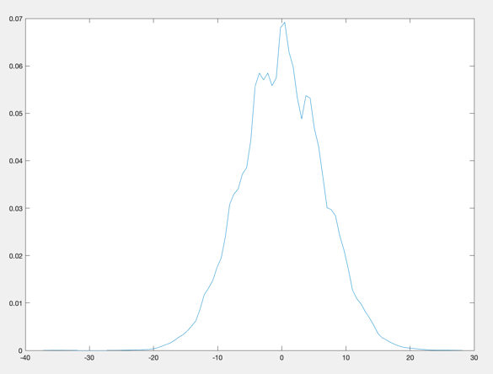
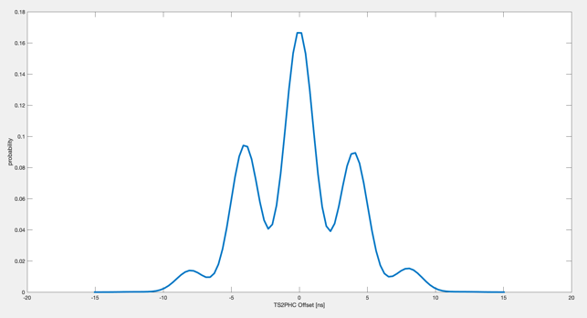
Performance
https://engineering.fb.com/2016/02/18/core-data/netnorad-troubleshooting-networks-via-end-to-end-probing/

Slide 13
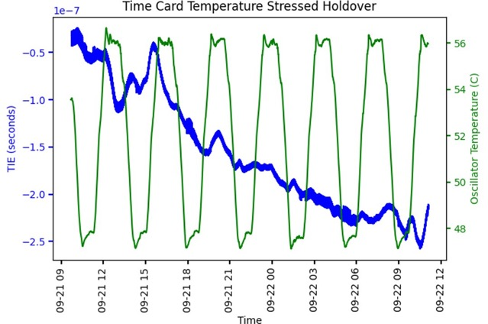
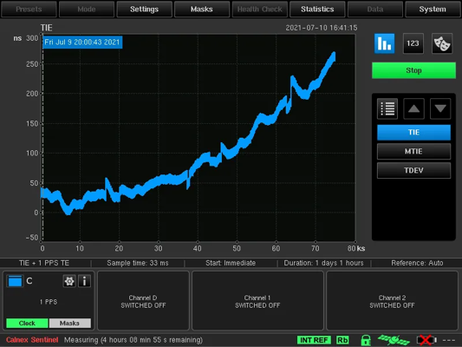
Performance
https://engineering.fb.com/2016/02/18/core-data/netnorad-troubleshooting-networks-via-end-to-end-probing/

Slide 14
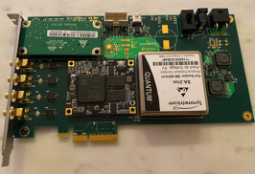
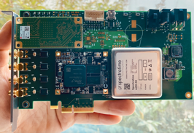
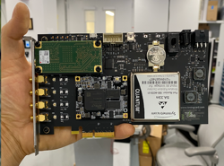
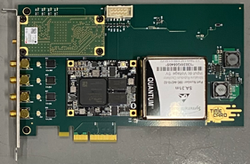
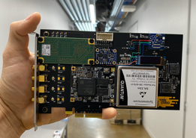
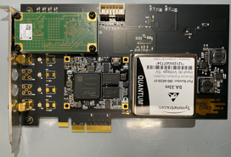
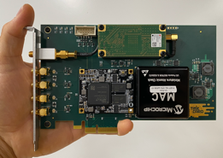
Previous Versions
Sep 2020
October 2020
December 2020
November 2020
February 2021
April 2021
March 2021
July 2021

Slide 15
Latest Versions
Dual GNSS with Rb Clock (SA.53)
Low Power with Cs Clock (SA.45s)
Can be found on www.timingcard.com

Slide 16
Acknowledgment

Slide 17
Thank You

